Slide 1
Government College of Engineering, Jalgaon (An Autonomous Institute of Government of Maharashtra)
ISA Tools – Presentation
Subject: SH 386U IOM Sem: III
Branch: S.Y. B.Tech. CO 2024-25
Topic Name:Project Selection and Appraisal
Name of the Student: Himanshu Ganesh Firke
PRN No: DSY
Name of the faculty: Dr. Shashank R. Zope

Slide 2


Project Selection and Appraisal
Project selection and appraisal are crucial for success. A systematic approach ensures that projects align with strategic goals, optimize resource allocation, and minimize risk.
by Himanshu Firke

Slide 3
SWOT (Strength, Weakness, Opportunities, Threats) Analysis
Strengths
Weaknesses
Opportunities
Internal capabilities that provide a competitive advantage. This could include strong brand recognition, talented workforce, or innovative technology.
Areas where the organization lacks resources or expertise. Examples include limited market reach, outdated equipment, or inefficient processes.
Favorable external factors that can be leveraged for growth. This could be expanding into new markets, adopting emerging technologies, or partnering with other companies.

Slide 4
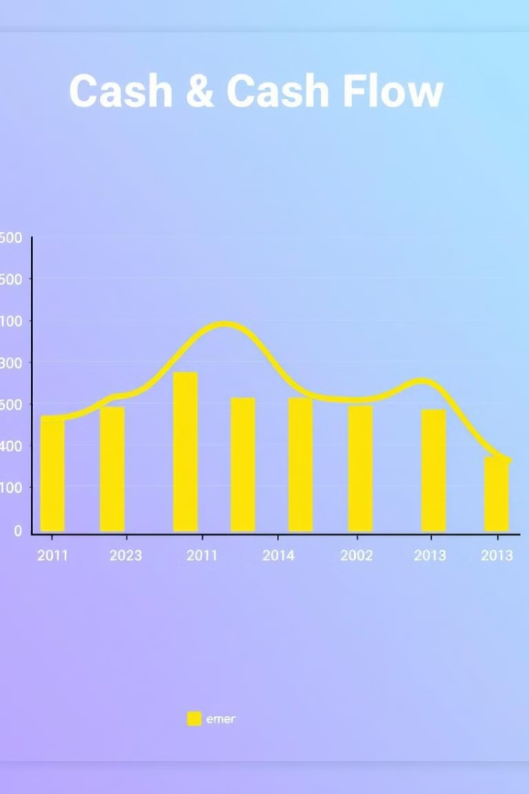
Cash Flow Analysis
1
Inflows
Money coming into the project from various sources, such as sales revenue, grants, or investments.
2
Outflows
Money leaving the project, including operational costs, capital expenditures, and debt repayments.
3
Net Cash Flow
Difference between inflows and outflows. Positive net cash flow indicates a healthy project, while negative flow indicates a cash shortage.

Slide 5




Payback Period
Investment
Cash Flows
Payback Point
The initial cost of launching the project. It includes expenses like equipment, training, and marketing.
The revenue generated by the project throughout its lifecycle. It's essential to estimate cash flows accurately to determine the payback period.
The point in time when the cumulative cash inflows equal the initial investment. This indicates the project has paid for itself.

Slide 6

Aligning Strategic Objectives with Project Evaluation
1
Project Alignment
2
Performance Measurement
3
Decision Making
Projects should directly contribute to the organization's strategic goals, ensuring resource allocation is focused and impactful.
Key performance indicators should be defined and tracked to measure the project's progress and success in achieving strategic objectives.
The project evaluation should consider the project's alignment with strategic goals, its financial viability, and its potential impact on the organization.

Slide 7
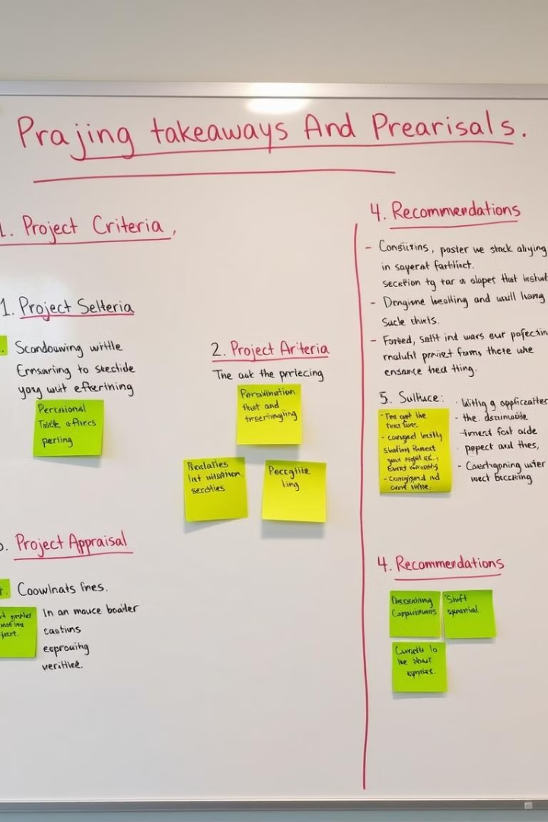
Key Takeaways and Conclusion
Strategic Alignment
Projects should be aligned with the organization's strategic goals.
Financial Viability
The project should be financially sustainable, with a positive return on investment.
Risk Mitigation
Potential risks should be identified and addressed through a comprehensive risk management plan.

Slide 8
Thank You…

